Slide 1

Modelling phase transitions: Characterising Henry's Law
Joshua Cheung
Supervised by Jo Grundy and Jeremy Frey
https://www.psdi.ac.uk/

Slide 2
Colours and Fonts (remove from final presentation)
Headings: Open Sans Condensed
Body Text: Lato
Colours: if these colour boxes match up the document has applied the colour theme.
Additional Colour:
#011e41
#002169
#3d7cc9
#ff9e18
#5aa2ae
#bbbbbb
#e5e1e6
#9d90a0
#993366

Slide 3

About me
2nd Year Chemistry with Digital Methods and Computational Modelling
Continuation of my project from last summer with PSDI: Modelling Miscibility with Machine Learning
I enjoy reading sci fi, gaming, and playing guitar

Slide 4
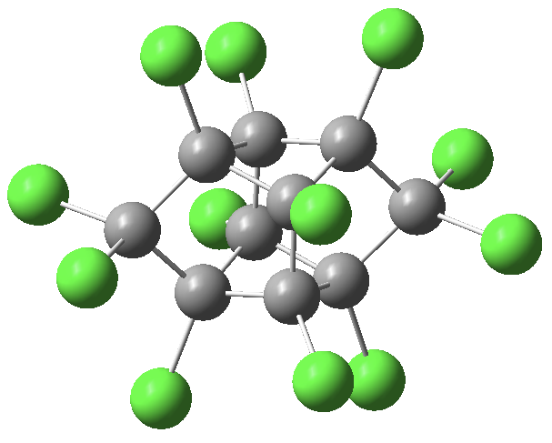
Presentation Outline
Project Description
Background
Methodology
Dataset Building
Data Processing
Machine Learning
Initial Results
Challenges
Future Work
Mirex, one of the compounds in the dataset

Slide 5
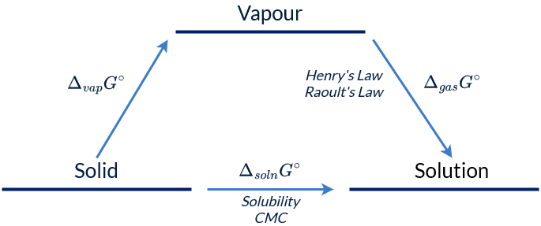
Project Description
Exploring the links between the Critical Micelle Concentration (CMC), Henry’s Law constant (k_{H}), and solubility (logS)
Important for pharmaceuticals, synthesis in industry, electrochemistry, etc.
Possible to calculate experimentally, but time consuming and difficult
Extremely computationally expensive to model using quantum mechanical simulations
Solution: Machine Learning!
Notes:
Properties are linked thermodynamically
Important in synthesis because generally reactions are performed in solution -> need to know if its dissolved or not
Takes at least 3 hours to determine Henry’s Law constant for a compound at a certain temperature -> have to control temperature in experimental conditions
Hard to model with QM because generally you have thousands/millions of particles in solution, and have to model every single one of them

Slide 6
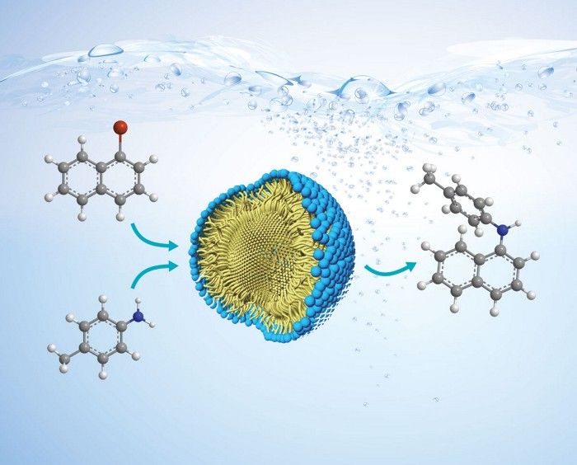
Background
Henry’s Law: The abundance of a volatile solute dissolved in a liquid is proportional to its abundance in the gas phase
Solubility: The analytical composition of a saturated solution, expressed in terms of the proportion of a designated solute in a designated solvent, is the solubility of that solute
Critical Micelle Concentration: The maximum concentration of a surfactant at which micelles do not form or the concentration at which micelles begin to form
Micelle: A tiny particle made of substances that are soluble in water and that come together to form a ball-like shape
A micelle enabling a reaction in water
https://iupac.org/recommendation/henrys-law-constants/
https://goldbook.iupac.org/terms/view/S05740
https://doi.org/10.1038/s41598-023-40466-1
https://www.cancer.gov/publications/dictionaries/cancer-terms/def/micelle
Notes:
Boring definitions – overall, just shoving a solid into water, or seeing how much of a gas can dissolve in water.
Next slide is project overview

Slide 7
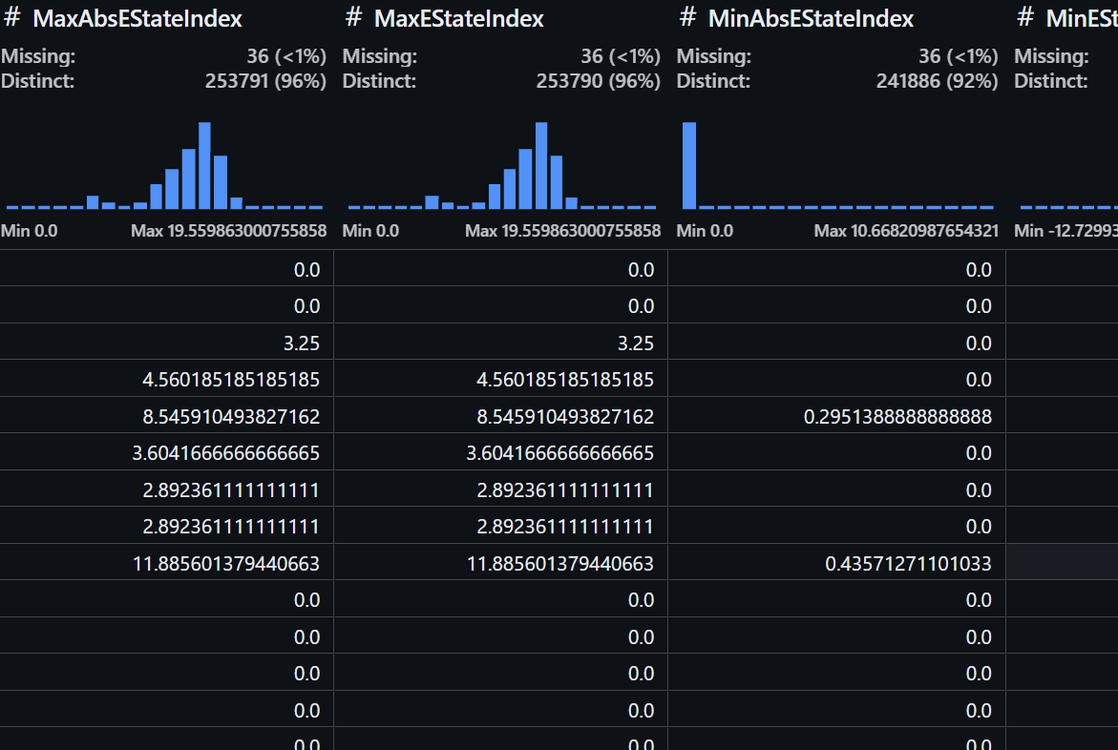
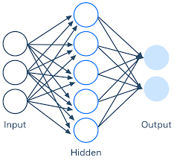
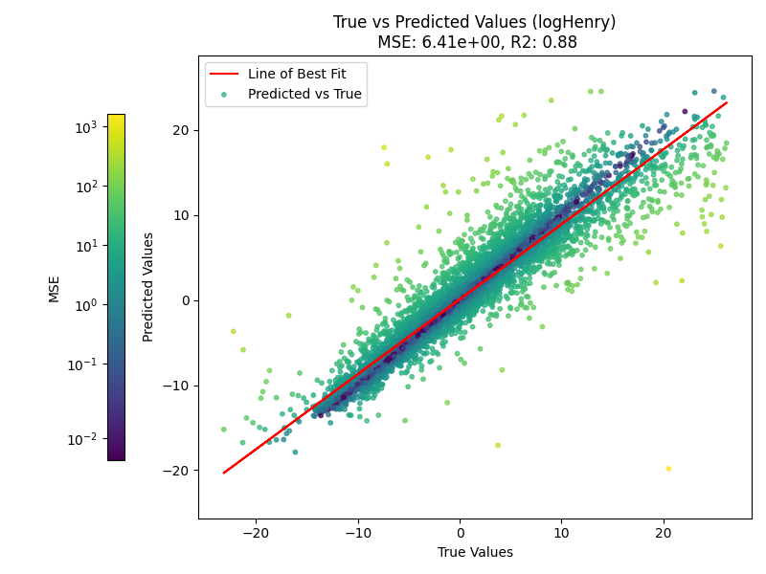
Project Overview
Dataset building
Data processing
Machine Learning
Results
Thermo
RDKit
NIST
Henry’s Law
IUPAC
Notes:
Overall process

Slide 8


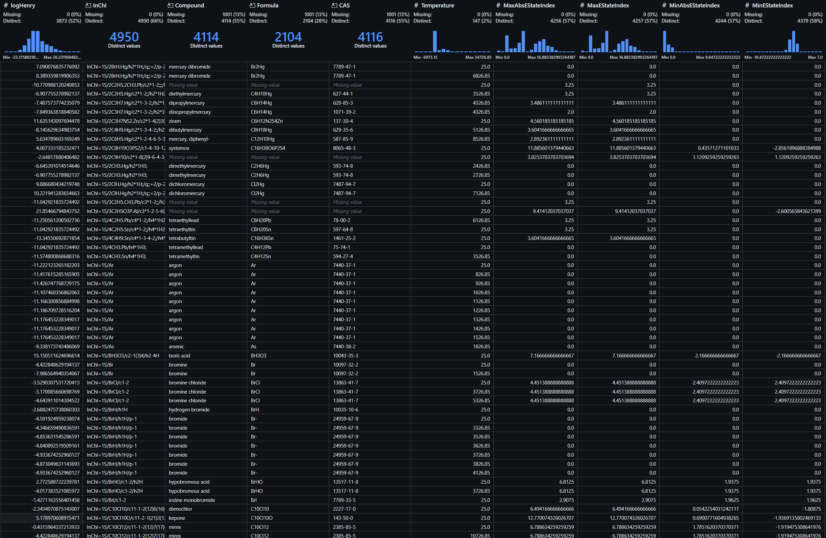


Dataset Building
Notes:
CMC – NIST, so old that it was called National Bureau of Standards, 1971, processed by Data Revival (Sam Munday)
Uses outdated conventional names/old iupac naming standards which have now changed. A lot of long carbon chain molecules
Hard to find smiles/cas/inchi
IUPAC – Solubility Data Series -> large set of datasets, some scanned typewritten
CAS identifiers, converted to smiles last year and then to inchi this year
Max Planck – Henry’s Law Constants, f90 file format, processed in python
CAS identifiers. Converted to inchi using cirpy, nist python api
RDKit – Molecular descriptors
Thermo – Thermodynamic properties (ultimately not used because data was too sparse)
Additionally:
Boiling/melting point data (not used)
Data from various papers

Slide 9
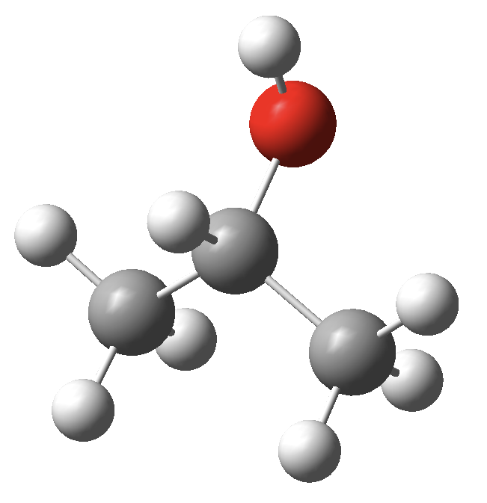
Dataset Building
Value | Count
Unique Compounds | 16 334
logS (solubility) | 15 094
CMC | 930
Henry’s Law | 7 642
Total Entries | 20 798
Isopropyl Alcohol, the most abundant chemical in the dataset
Notes:
Stats
Some overlap between HL and solubility
Pretty much no overlap with CMC data

Slide 10
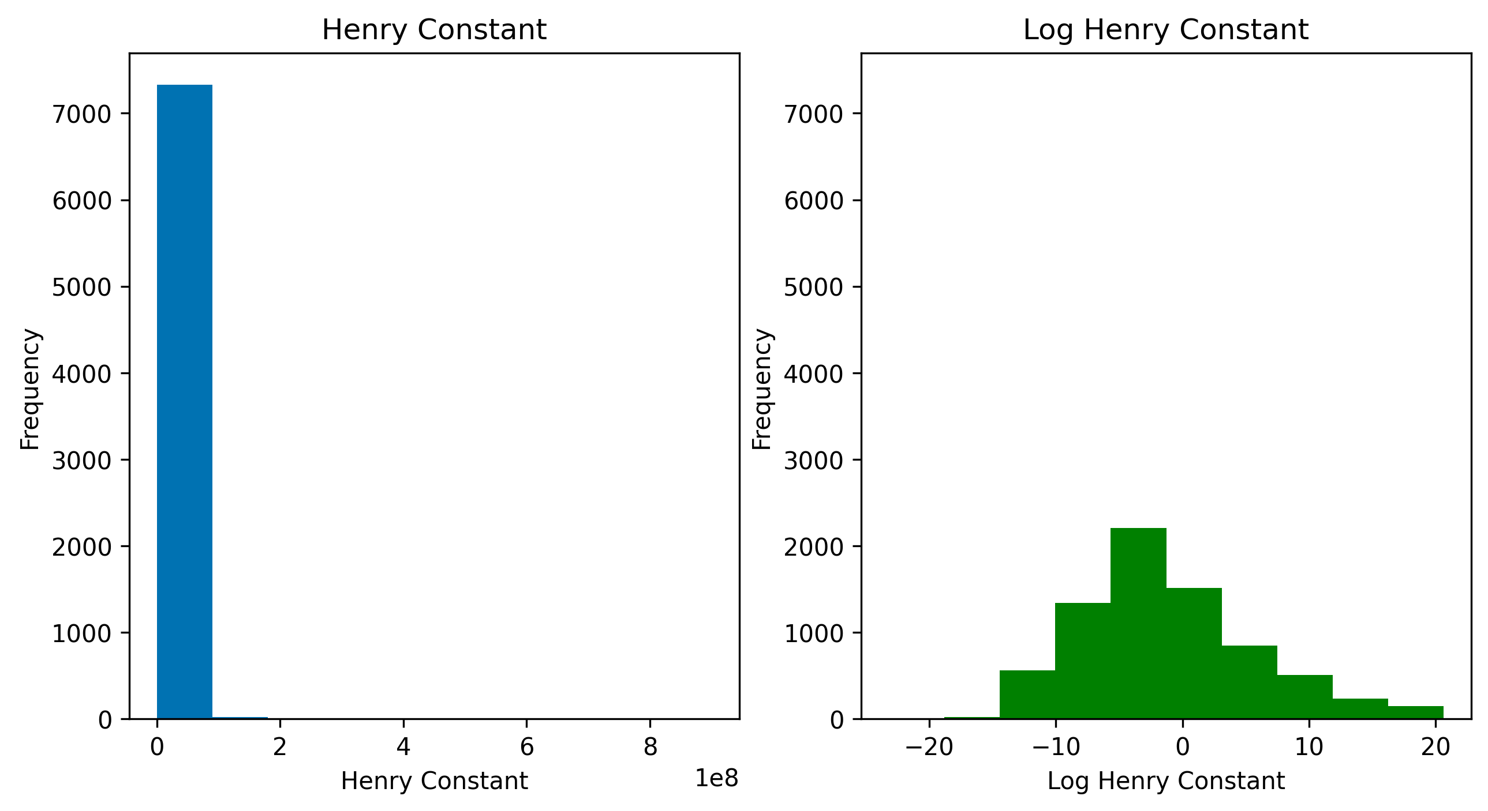
Data Processing
226 features reduced to <200 (removing null values, columns with 0 variance, etc)
Determination of which scaling method works best
Feature selection
For Henry Constant, anything above 10e+10 removed
Normalisation | Scaling Method | MSE | R²
None | None | 5.64 | 0.90
MinMax | RobustScaler() | 6.41 | 0.88
MinMax | StandardScaler() | 6.83 | 0.87
None | Normalize | 7.37 | 0.86
Normalize | MaxAbsScaler() | 7.64 | 0.86
Scores by scaling method for logK_{H}
Notes:
Scaling affects distribution of data, makes it easier for model to effectively differentiate between values
Feature selection tested variety of different ways, eventually just removed anything with <1% distinct values

Slide 11

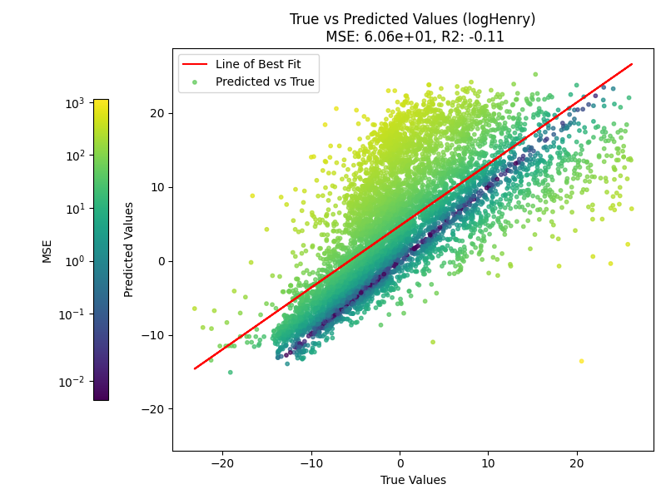
Machine Learning
MinMax -> RobustScaler
Initial testing done with linear regression and LightGBM (chosen due to speed)
Tree based gradient boosting model -> trains a weak model at each step and improves iteratively
Mostly just used so far for determining best scaling method and feature selection
MinMax -> Power Transformer
Notes:
Plots are example of how scaling affects results

Slide 12
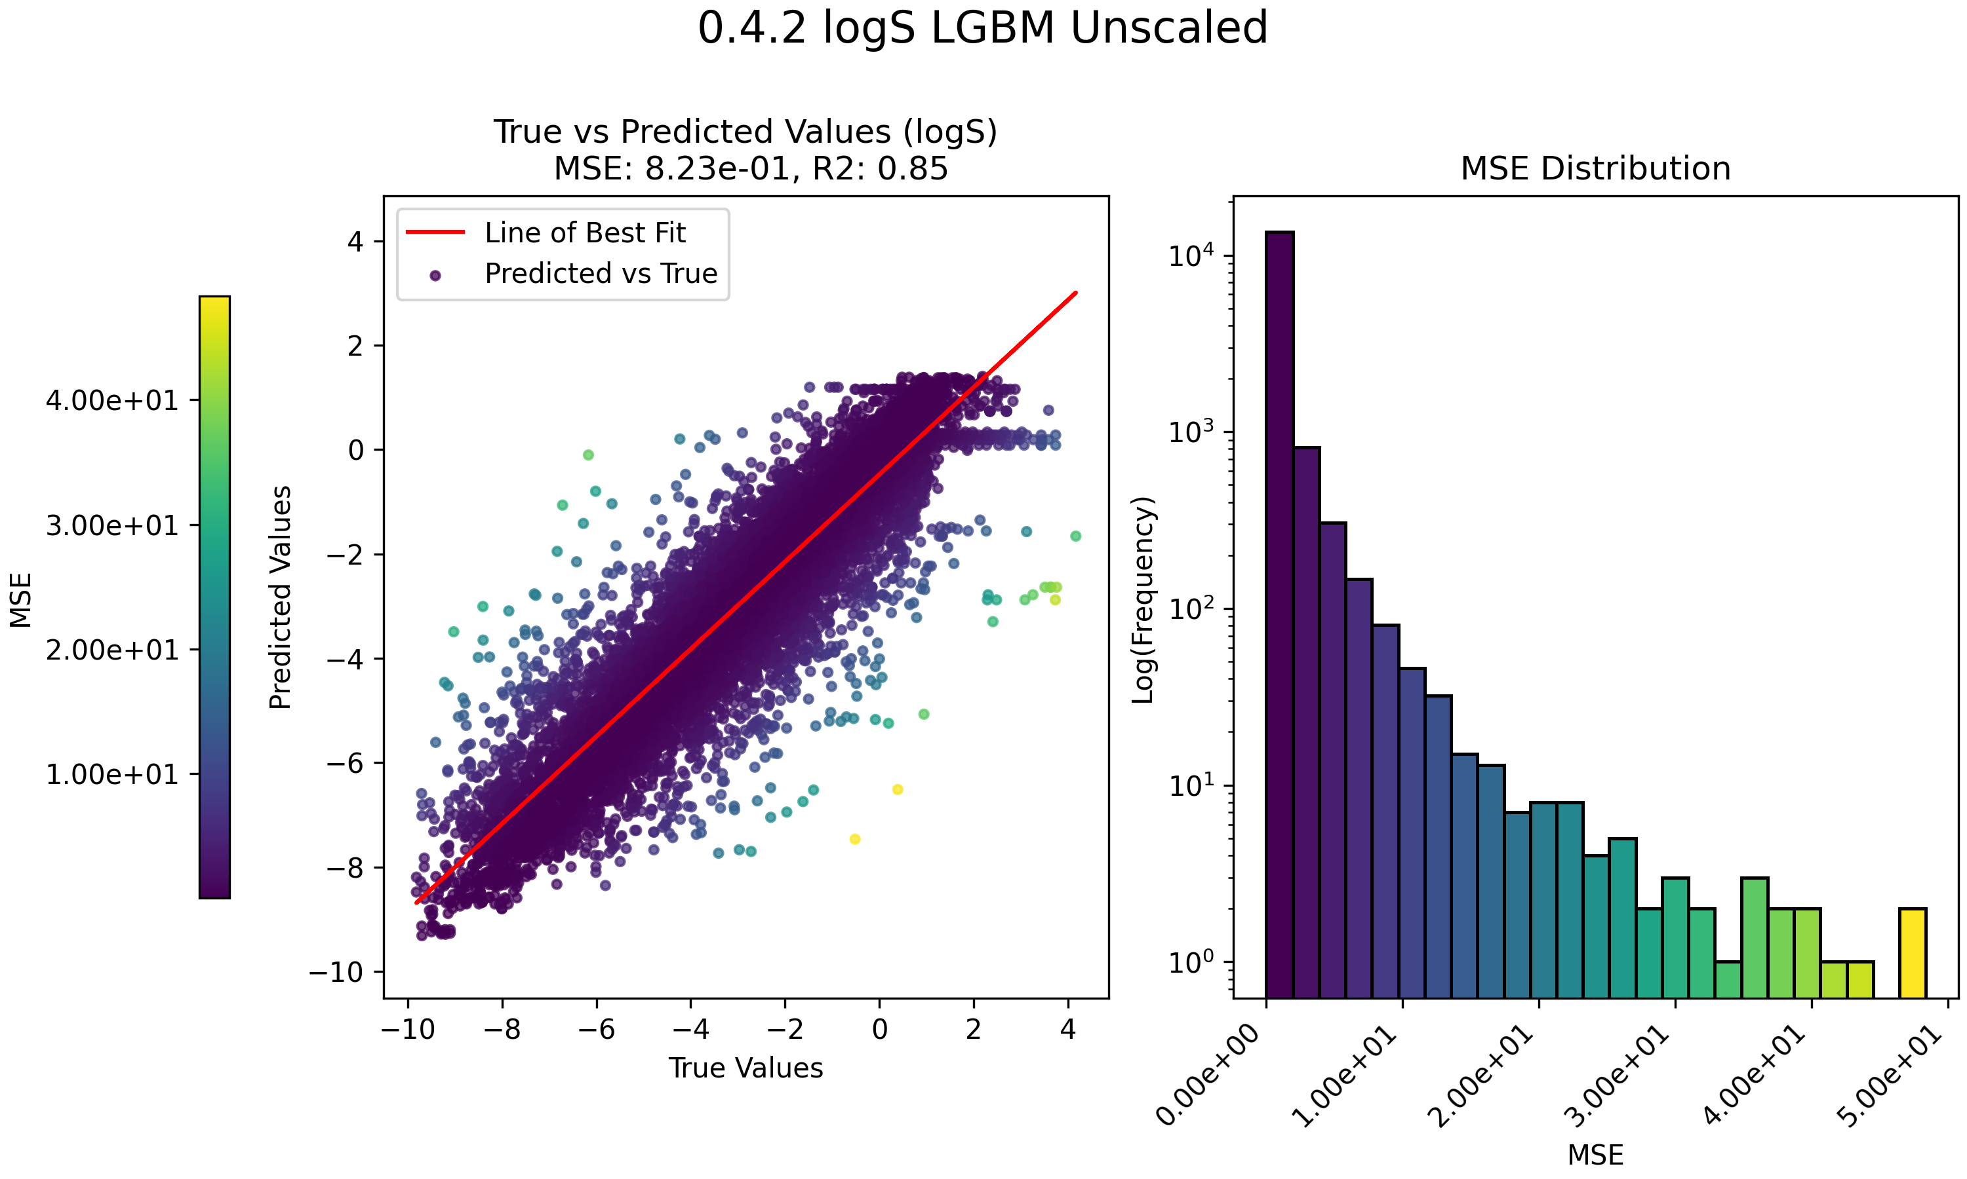
Machine Learning Results
Starting to get some results
Tested Kernel Ridge, K Nearest Neighbours, LightGBM, RandomForest and Linear Regression so far
Using GridSearchCV to optimize parameters
Notes:
Note log scaled frequency in histogram

Slide 13
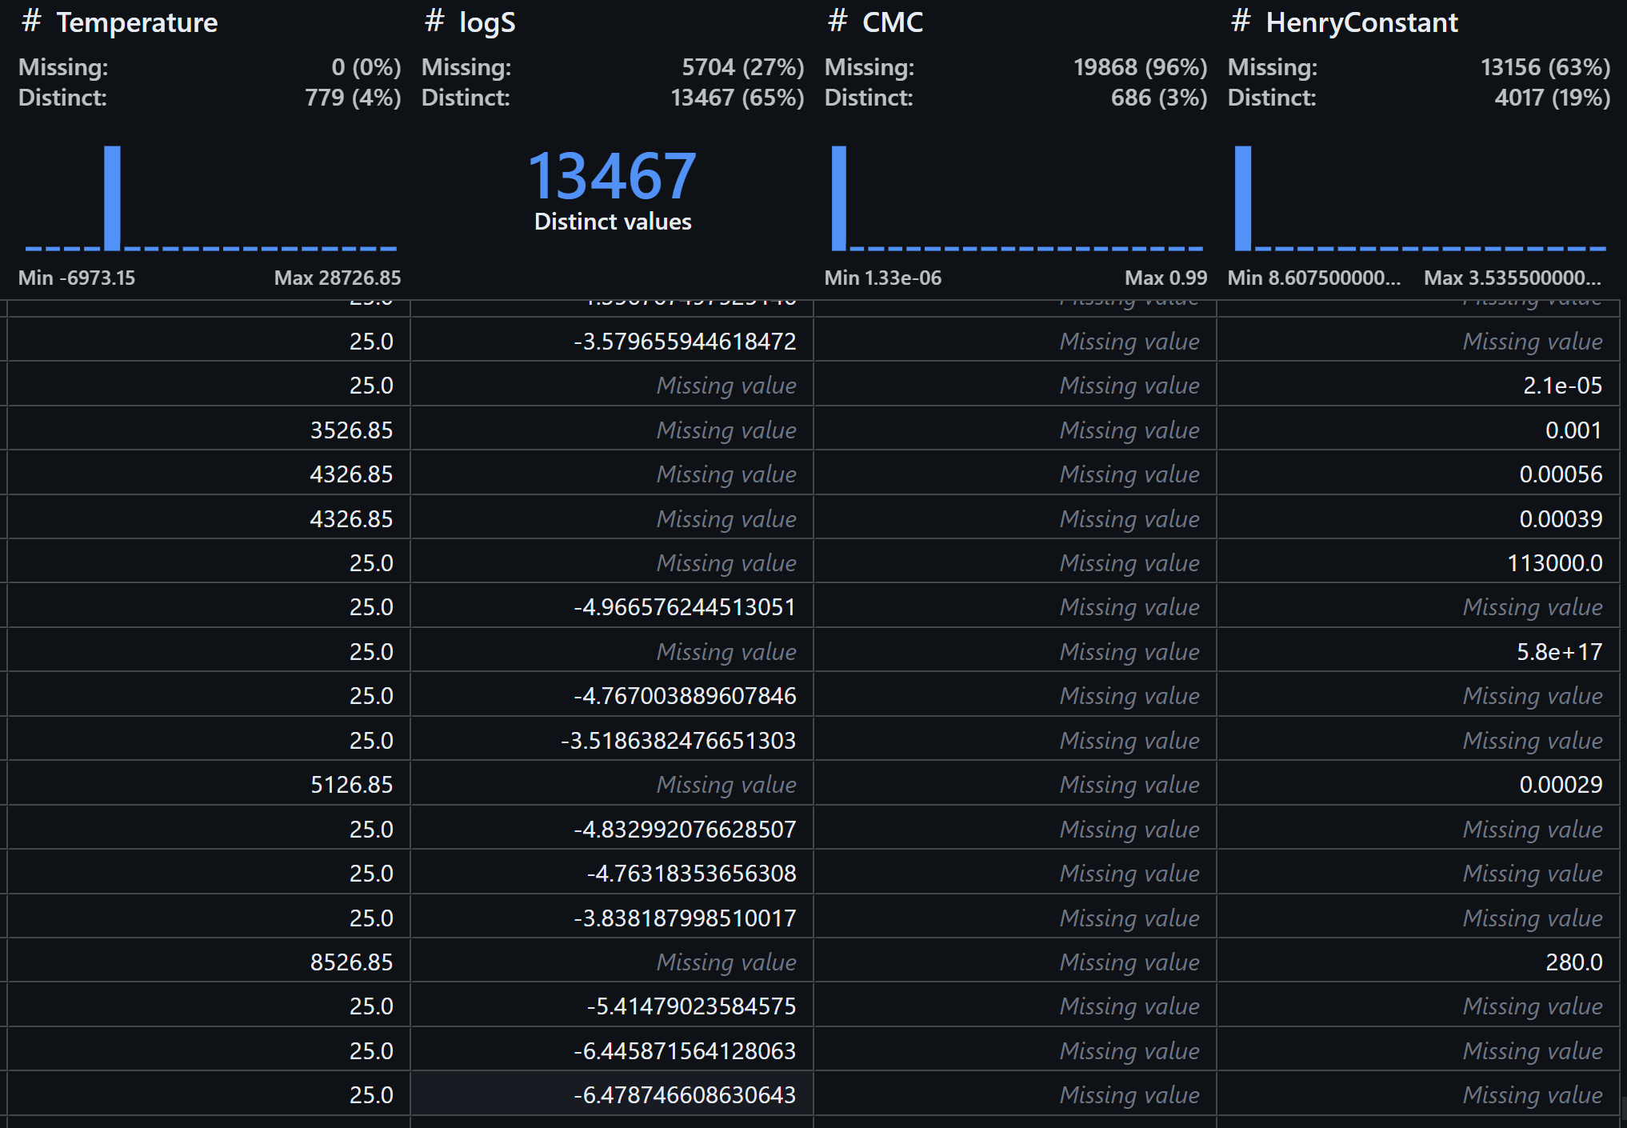
Challenges
Endless debugging
Quantity of data, especially for CMC
Quality of data – the values of Henry’s Constant range from 8.6e-11 to 3.53e+39
A lot of missing temperature values, which are assumed to be 25 degrees Celsius
Lack of data at wide and continuous range of temperatures (e.g. solubility data at fixed intervals of 10 c)
Notes:
Picture is example of dataset overall -> lots of missing values visible

Slide 14
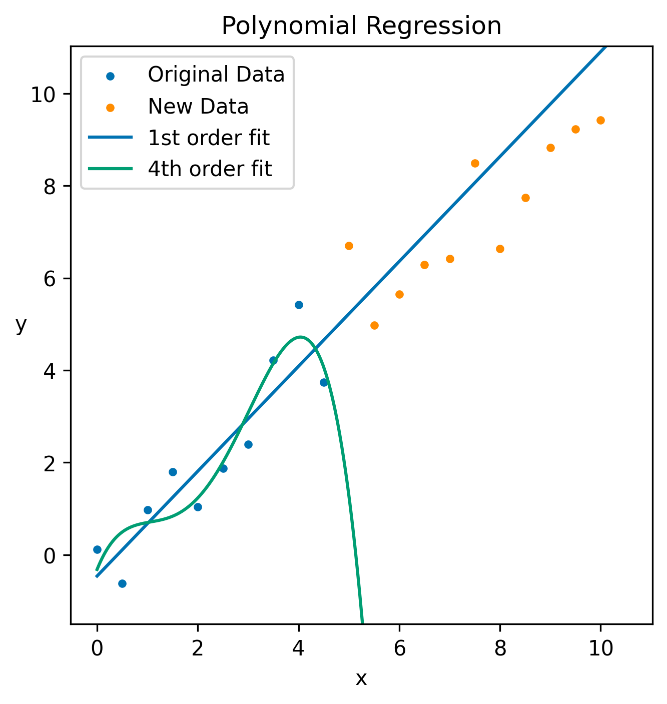
Why Data is a Challenge
Randomly generated data based around y = x, lines fit to data from 0 to 5.
Overfitting/Underfitting
Ability to generalize to new data
Dimensionality

Slide 15
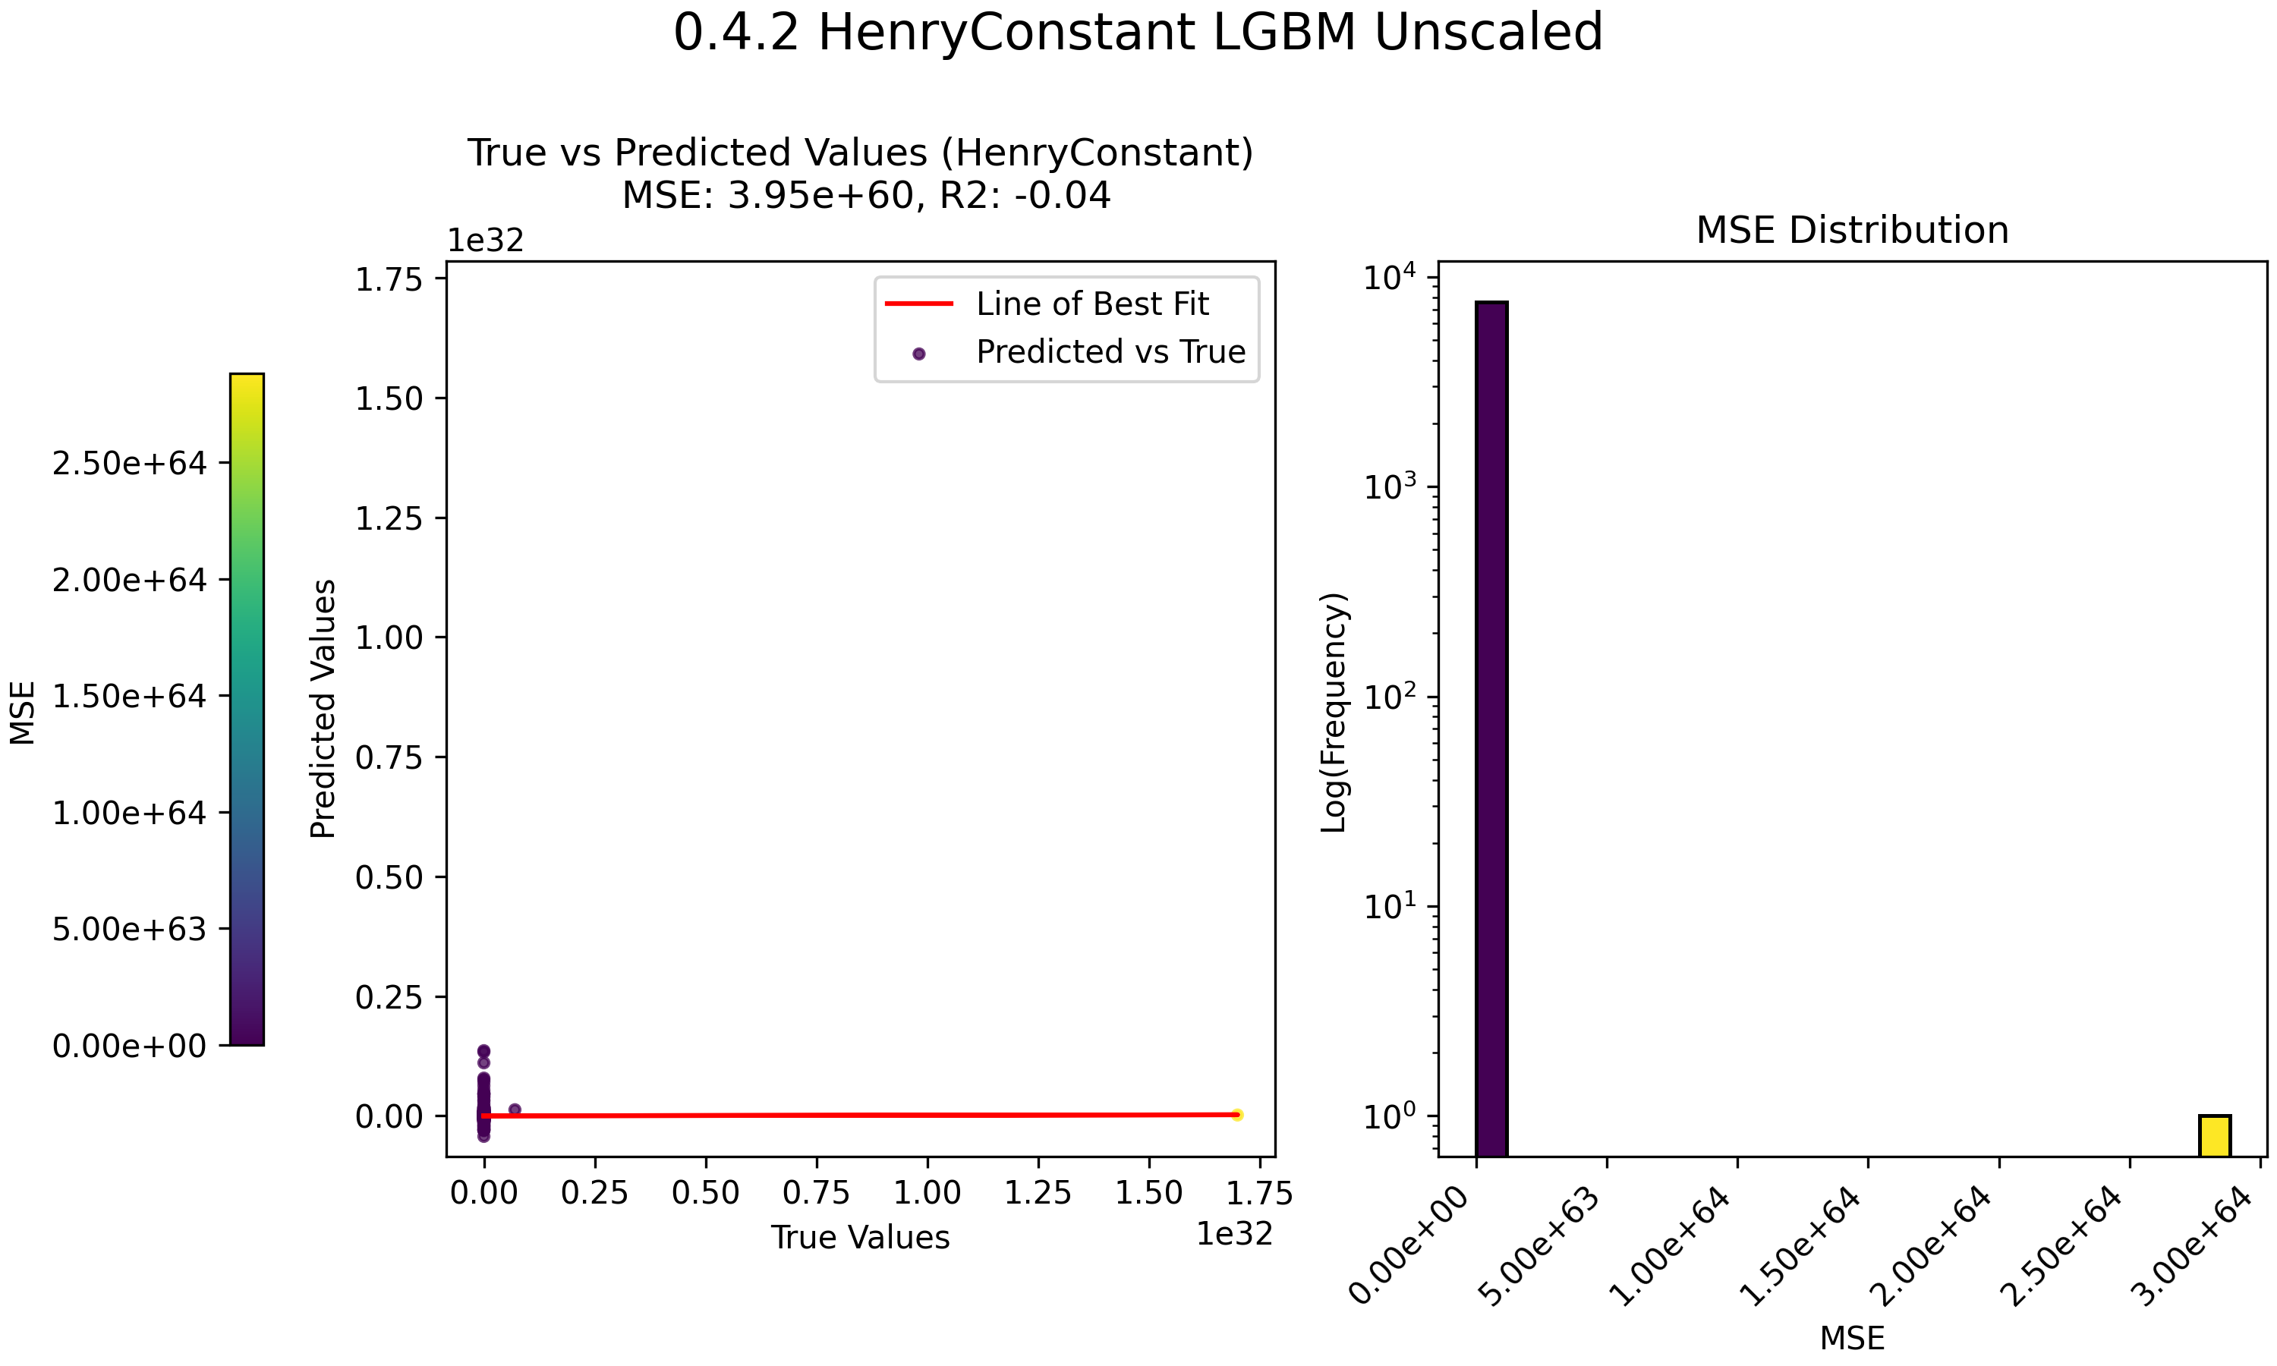
Notes:
Example of poor data quality – just a few random points at ~10e32 throwing the whole thing off massively
Henry’s law data eventually filtered so nothing greater than 10^10 remaining, model was struggling, high MSE

Slide 16
Plans for Part 2
Optimise machine learning models
Experiment with different algorithms, e.g. Neural Network
Hopefully get some good predictions, maybe start making some phase diagrams

